Slide 1
Female reproductive organs

Slide 2
introduction
Introduction to the Female Reproductive System
The female reproductive system is a specialized biological system responsible for producing female gametes (ova), facilitating fertilization, supporting the development of the embryo, and enabling childbirth. It consists of internal organs (ovaries, fallopian tubes, uterus, vagina) and external genitalia (vulva, clitoris, labia). Along with these, the system is regulated by various hormones (estrogen, progesterone, FSH, LH) that coordinate menstrual cycles, ovulation, and pregnancy.

Slide 3
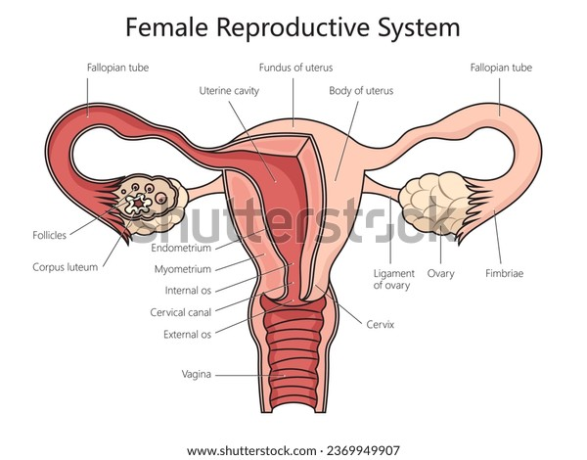
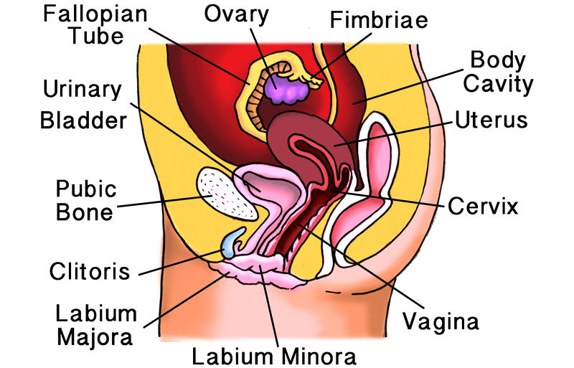
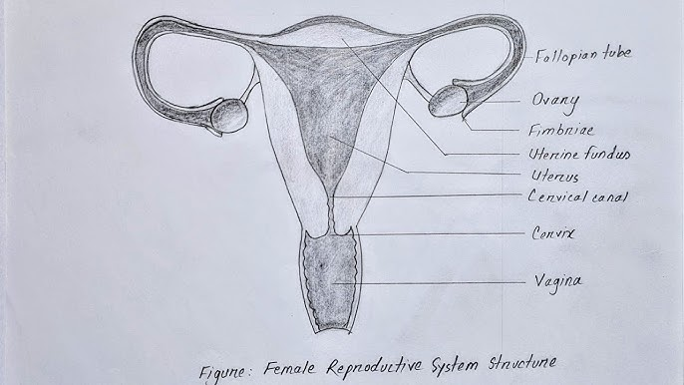

Slide 4
Functions of the Female Reproductive System
Production of Gametes (Oogenesis)
Ovaries produce female sex cells (ova/eggs).
This process starts before birth and continues after puberty in a cyclic manner.
Hormone Secretion
Ovaries secrete estrogen and progesterone.
These regulate menstrual cycle, secondary sexual characteristics, pregnancy, and bone health.
Transportation of Gametes
Fallopian tubes transport the ovum from the ovary to the uterus.
They also provide the site for fertilization.
Fertilization Site
The ampulla of the fallopian tube is the usual site of fertilization where sperm meets ovum.

Slide 5
Functions of the Female Reproductive System
Nourishment and Development of Embryo
The uterus provides an environment for implantation of the fertilized egg.
It supports the growth and nourishment of the embryo and fetus during pregnancy.
Parturition (Childbirth)
The uterus, cervix, and vagina play major roles in delivering the baby at the end of pregnancy.
Menstrual Cycle Regulation
In absence of fertilization, the endometrial lining sheds periodically (menstruation).
This cycle prepares the body for possible pregnancy every month.
Lactation (Indirect Function)
Though part of the mammary glands, lactation is closely related to reproduction.
Provides nutrition and immunity to the newborn.

Slide 6
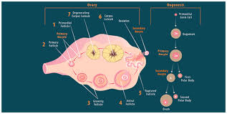
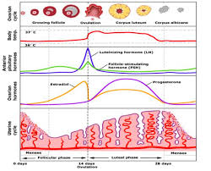
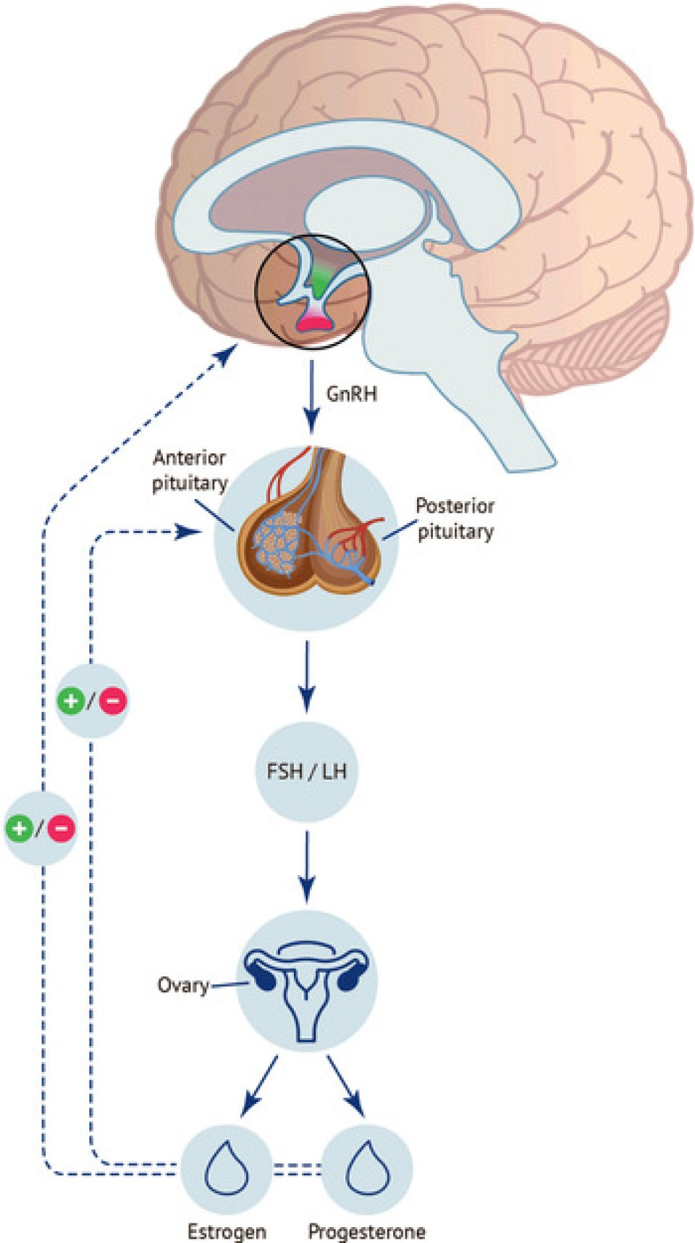
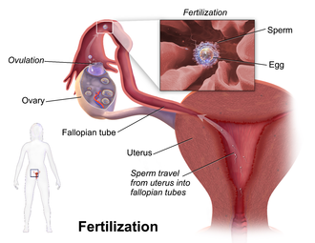
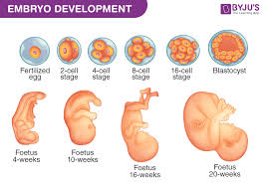

Slide 7
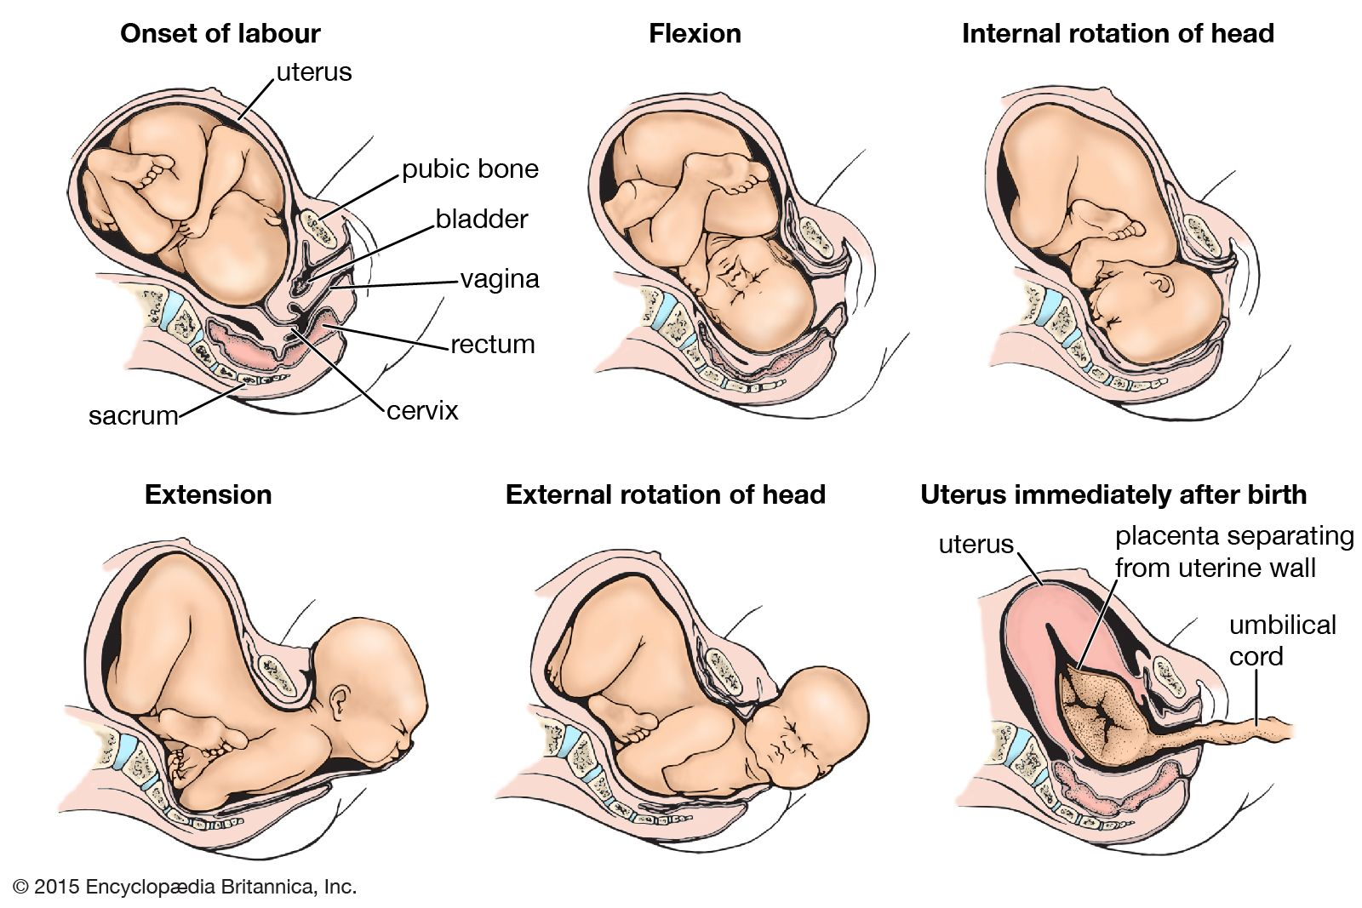
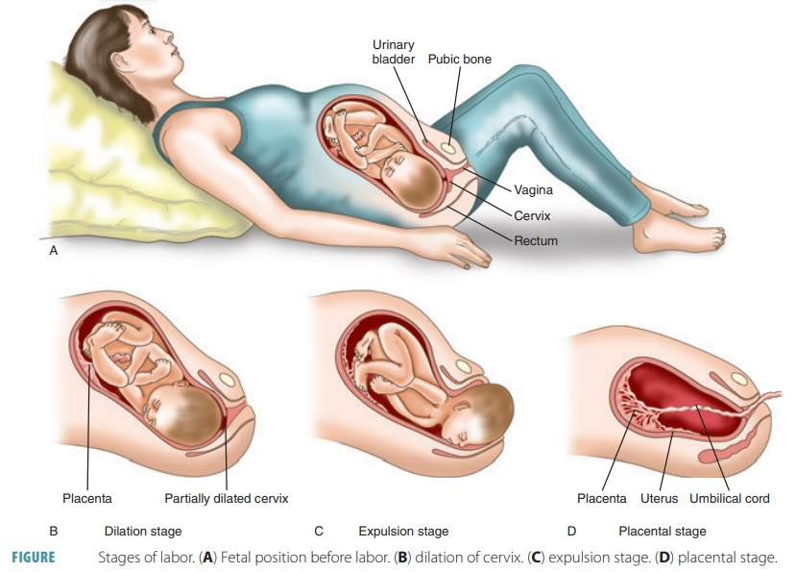
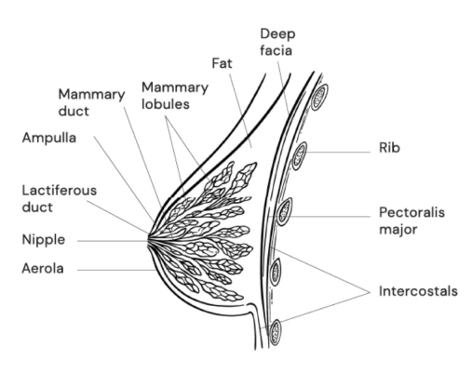
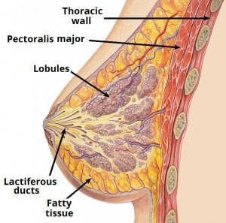

Slide 8
Applied Anatomy of the Female Reproductive System
1. Ovaries
Ectopic pregnancy: Fertilized ovum may implant outside uterus, often in fallopian tube but rarely on ovary.
Ovarian cysts/tumors: Can cause abdominal mass, torsion, or infertility.{PCOD}
Oophorectomy: Surgical removal of ovary (unilateral/bilateral).

Slide 9
Applied Anatomy of the Female Reproductive System
2. Fallopian Tubes
Tubal ligation: Permanent contraception by cutting or blocking the tubes. {tubectomy}
Ectopic pregnancy: Commonest site is the ampulla of tube → may rupture, causing life-threatening bleeding.
Salpingitis: Inflammation due to pelvic infections → may lead to infertility.

Slide 10
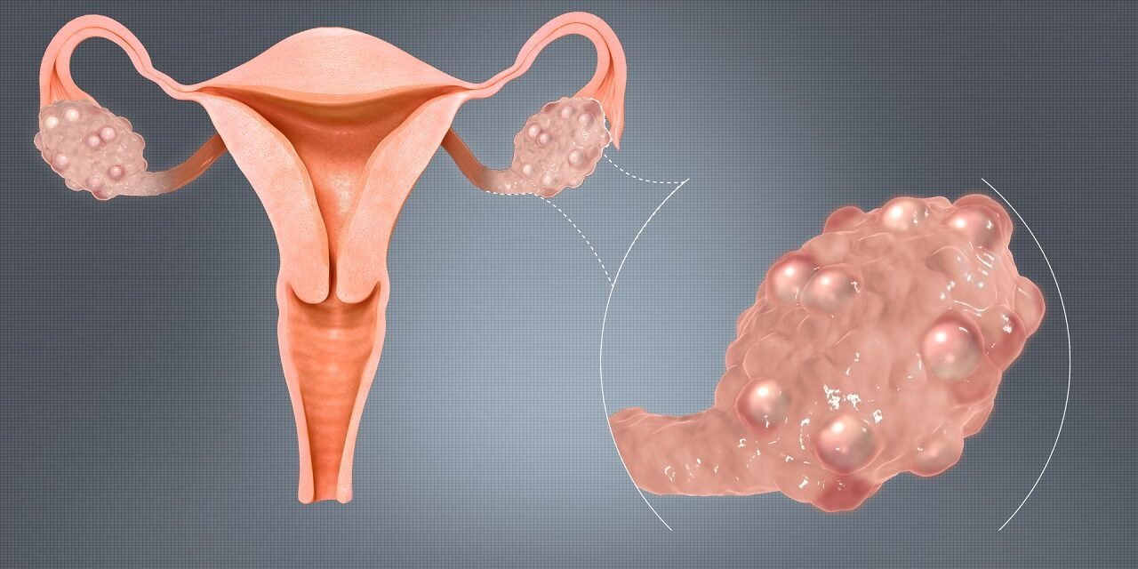
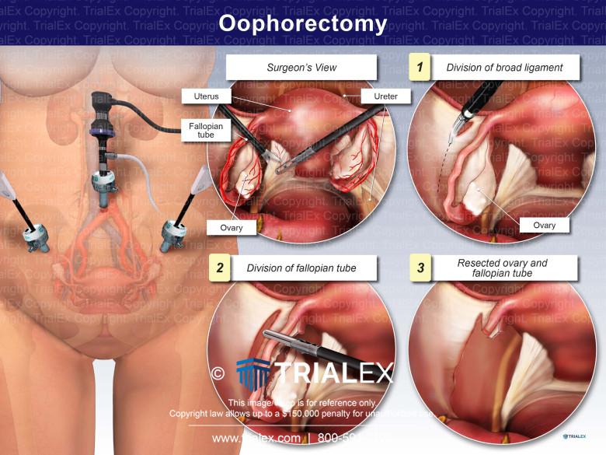
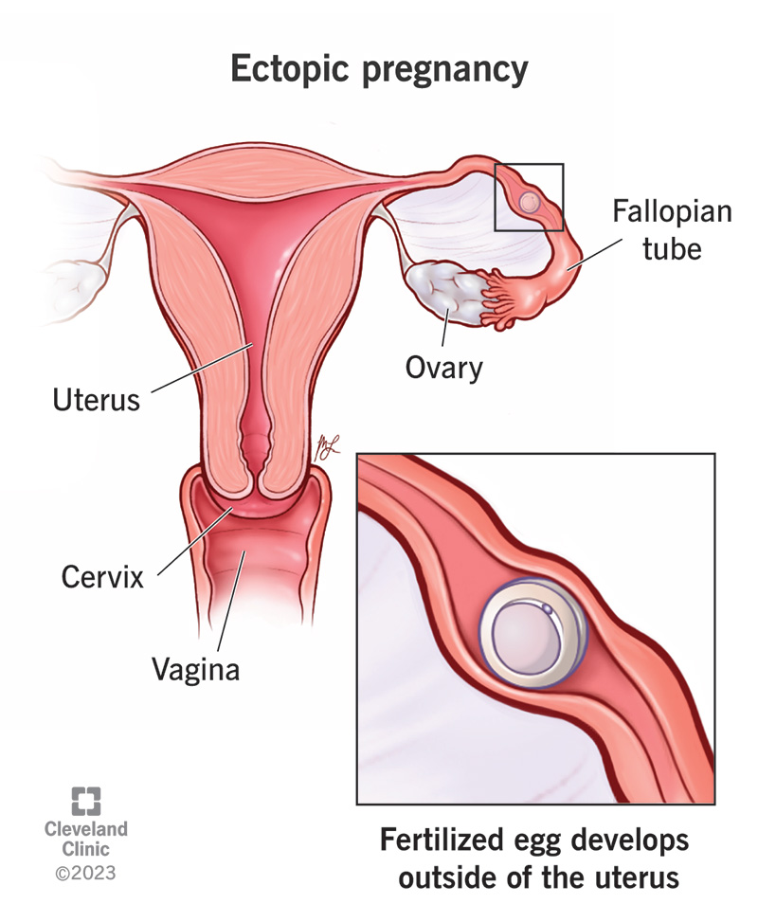
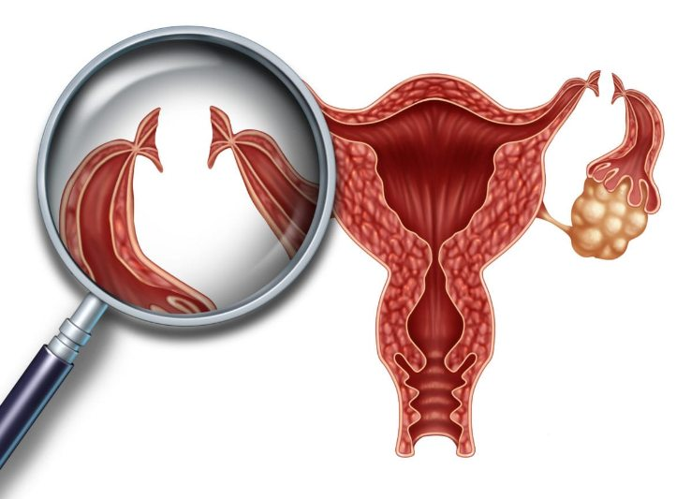
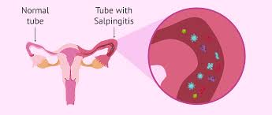

Slide 11
Applied Anatomy of the Female Reproductive System
3. Uterus
Prolapse of uterus: Descent of uterus into the vagina due to weakness of pelvic floor and ligaments.
Fibroids (leiomyomas): Benign tumors of uterine wall causing heavy bleeding and infertility.
Endometriosis: Presence of endometrial tissue outside uterus → dysmenorrhea (painful menstruation), infertility.
Caesarean section: Surgical incision in lower uterine segment for delivery.
Hysterectomy: Surgical removal of uterus (due to tumors, prolapse, severe bleeding, etc.).

Slide 12
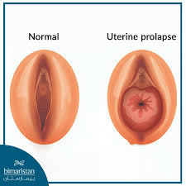
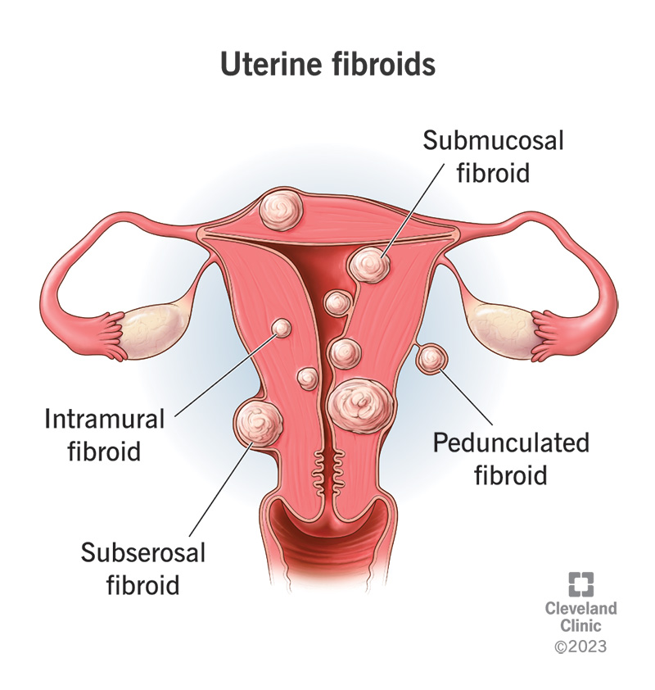
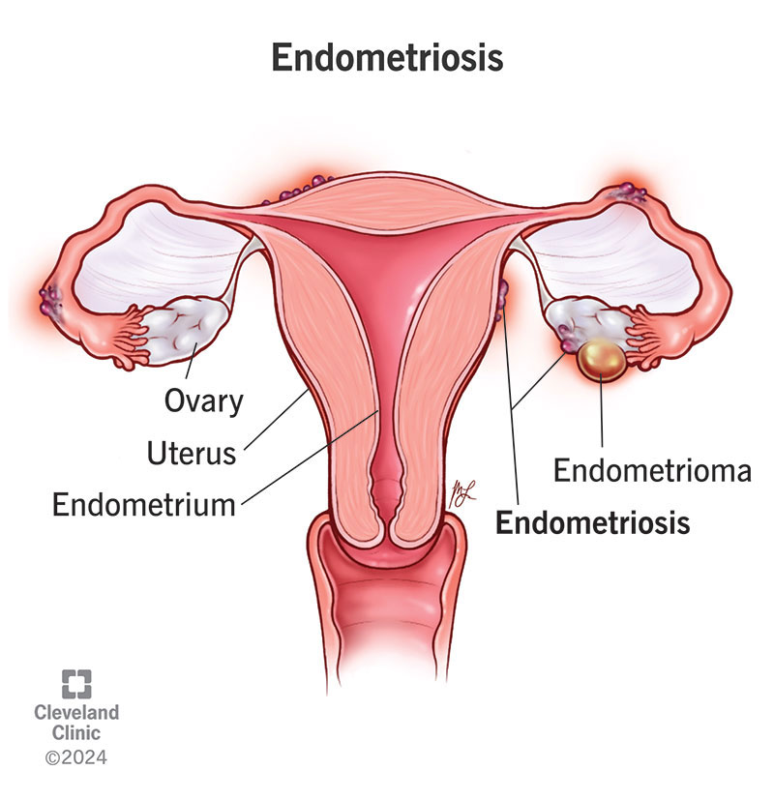
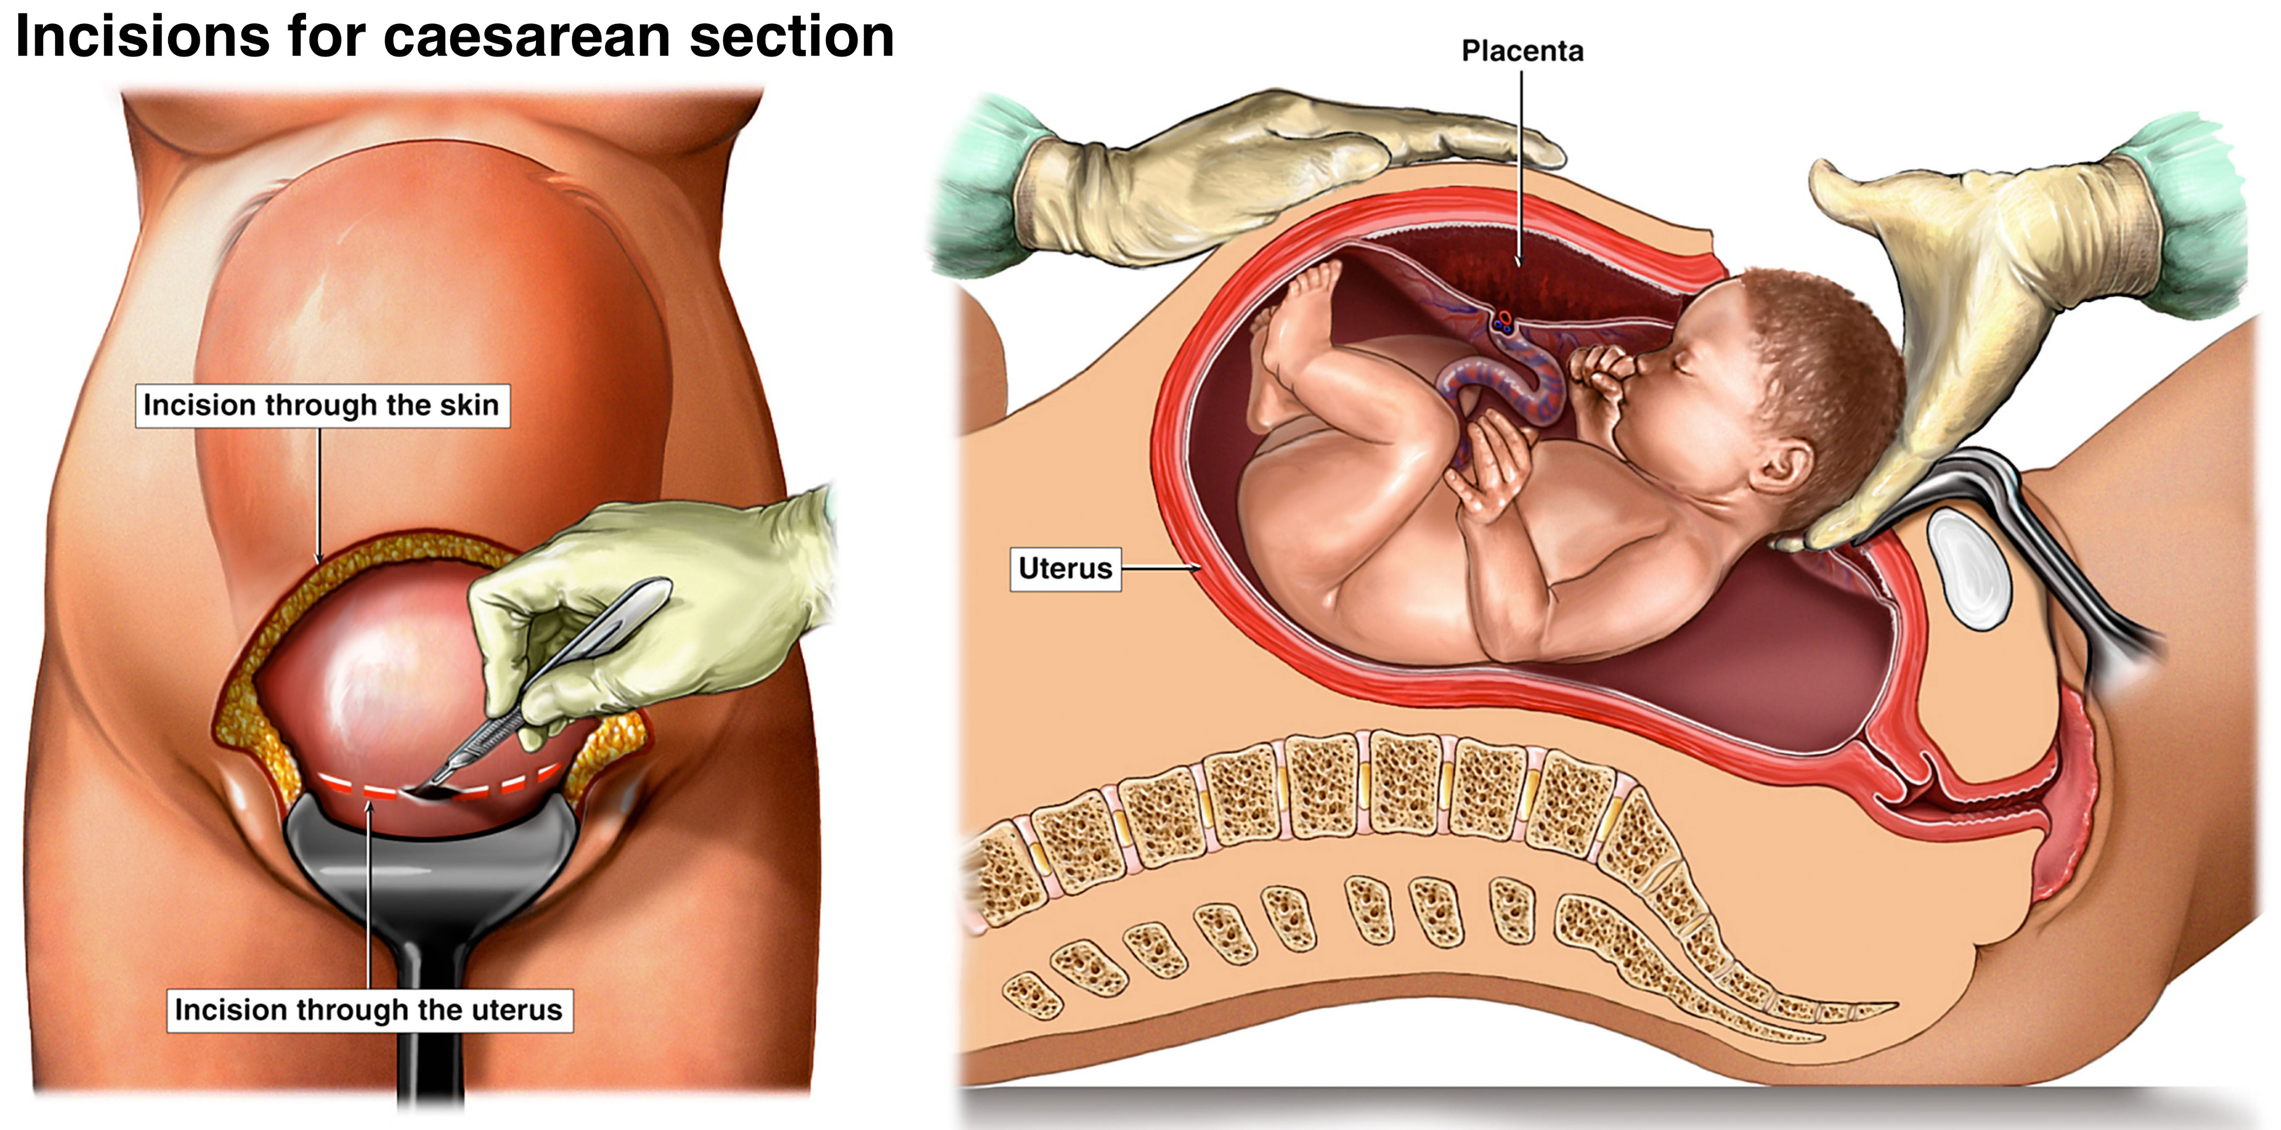
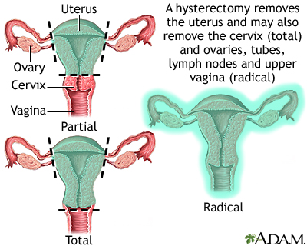

Slide 13
Applied Anatomy of the Female Reproductive System
4. Cervix
Carcinoma cervix: Common gynecological cancer; screening done via Pap smear.
Cervical incompetence: Leads to recurrent miscarriages, treated with cerclage (stitching cervix).
Cervical dilation: Necessary during labor; sometimes induced artificially.

Slide 14
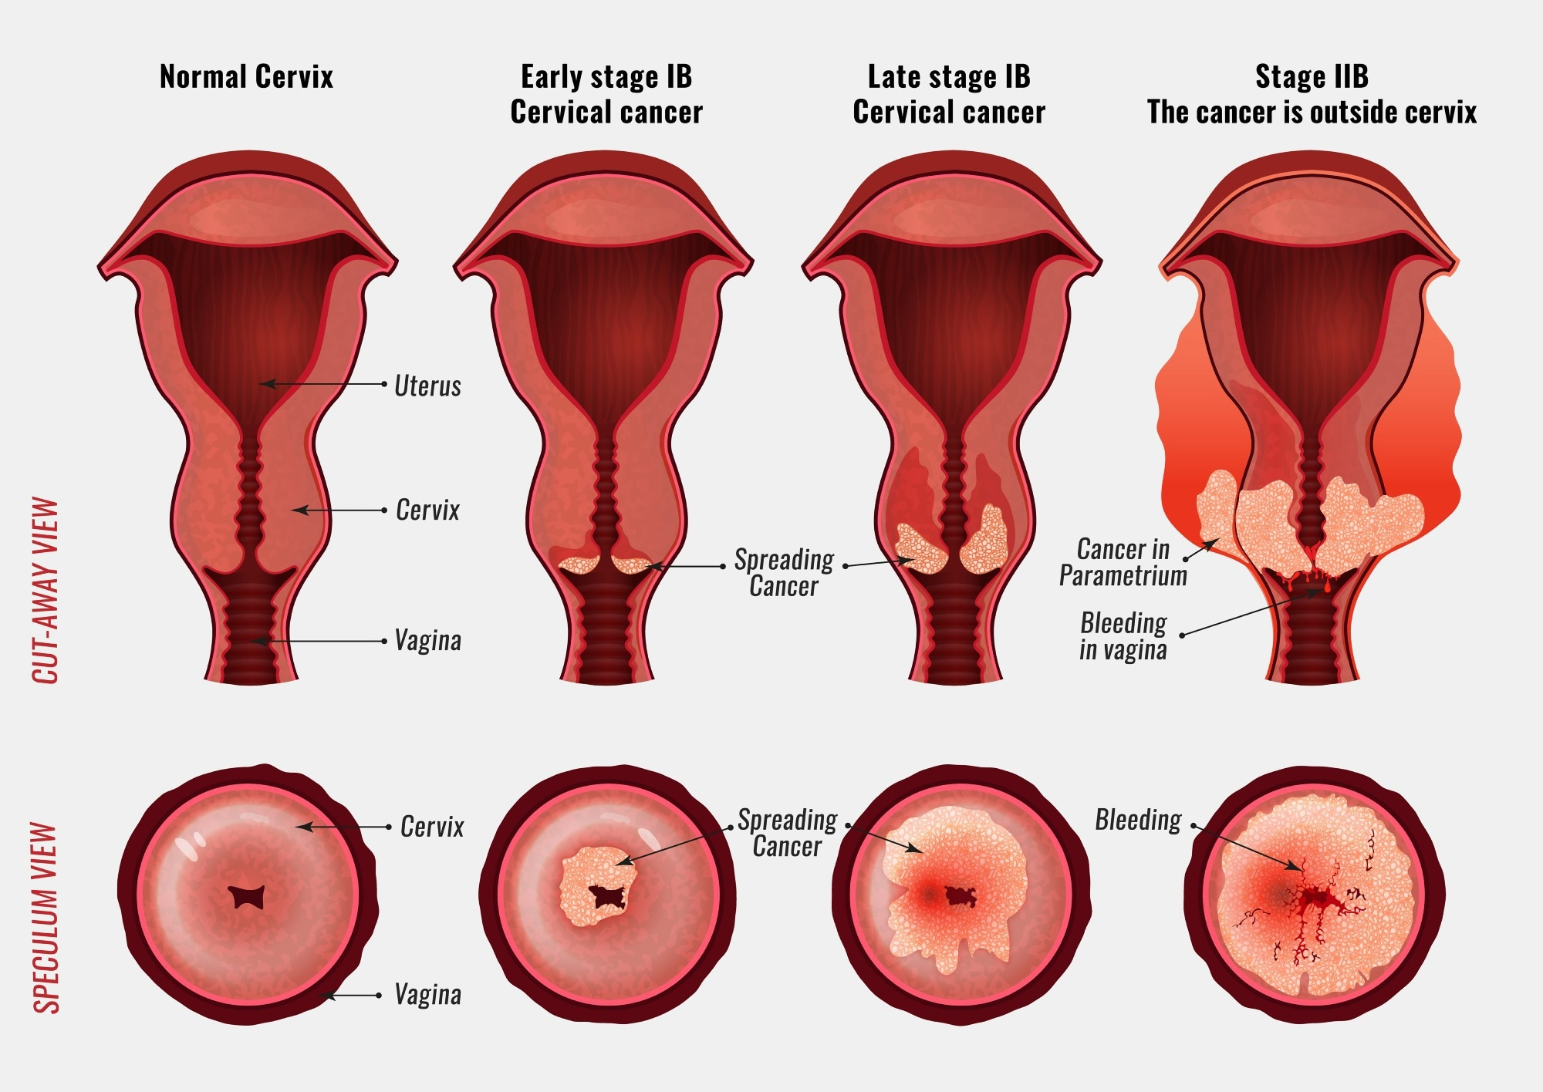
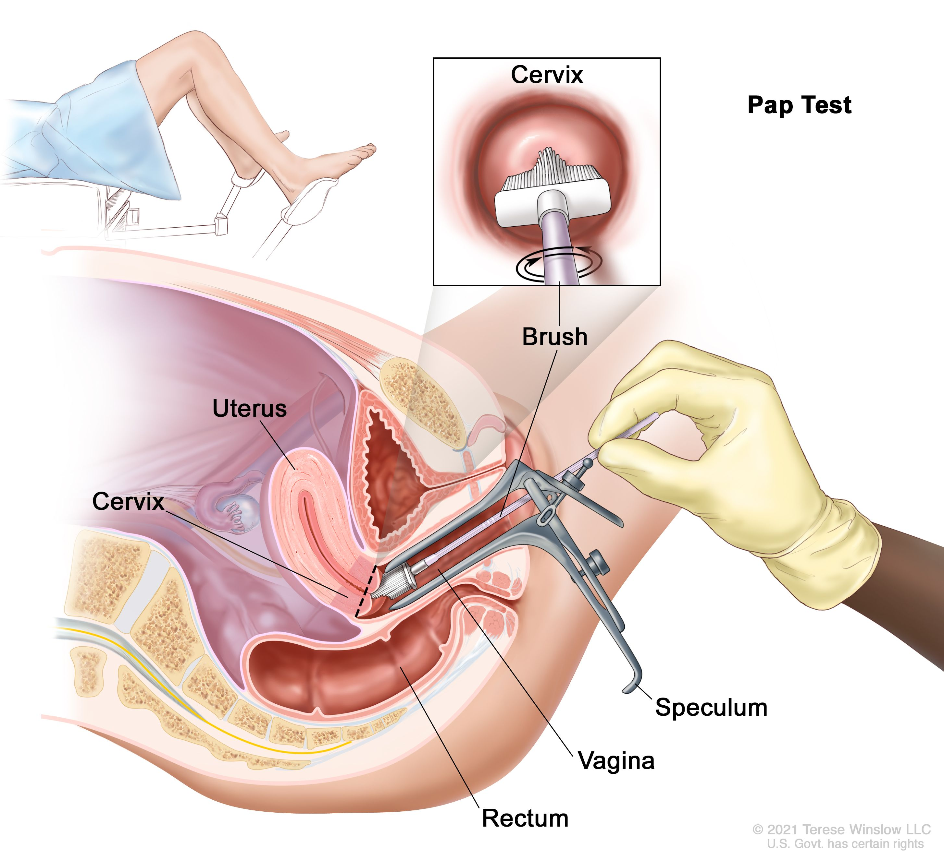
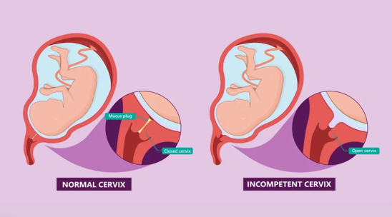
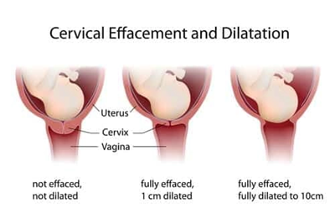

Slide 15
Applied Anatomy of the Female Reproductive System
5. Vagina
Birth canal: Important in normal delivery.
Vaginal tears: During childbirth, repaired surgically.
Vaginal infections: Candidiasis, bacterial vaginosis, trichomoniasis.
Pessary insertion: Used in cases of uterine prolapse

Slide 16
Applied Anatomy of the Female Reproductive System
6. Pelvic Floor & Perineum
Episiotomy: Surgical incision in perineum during difficult delivery to prevent uncontrolled tears.
Pelvic floor weakness: Leads to prolapse of uterus, bladder (cystocele), or rectum (rectocele).
Kegel’s exercises: Strengthen pelvic floor muscles.

Slide 17
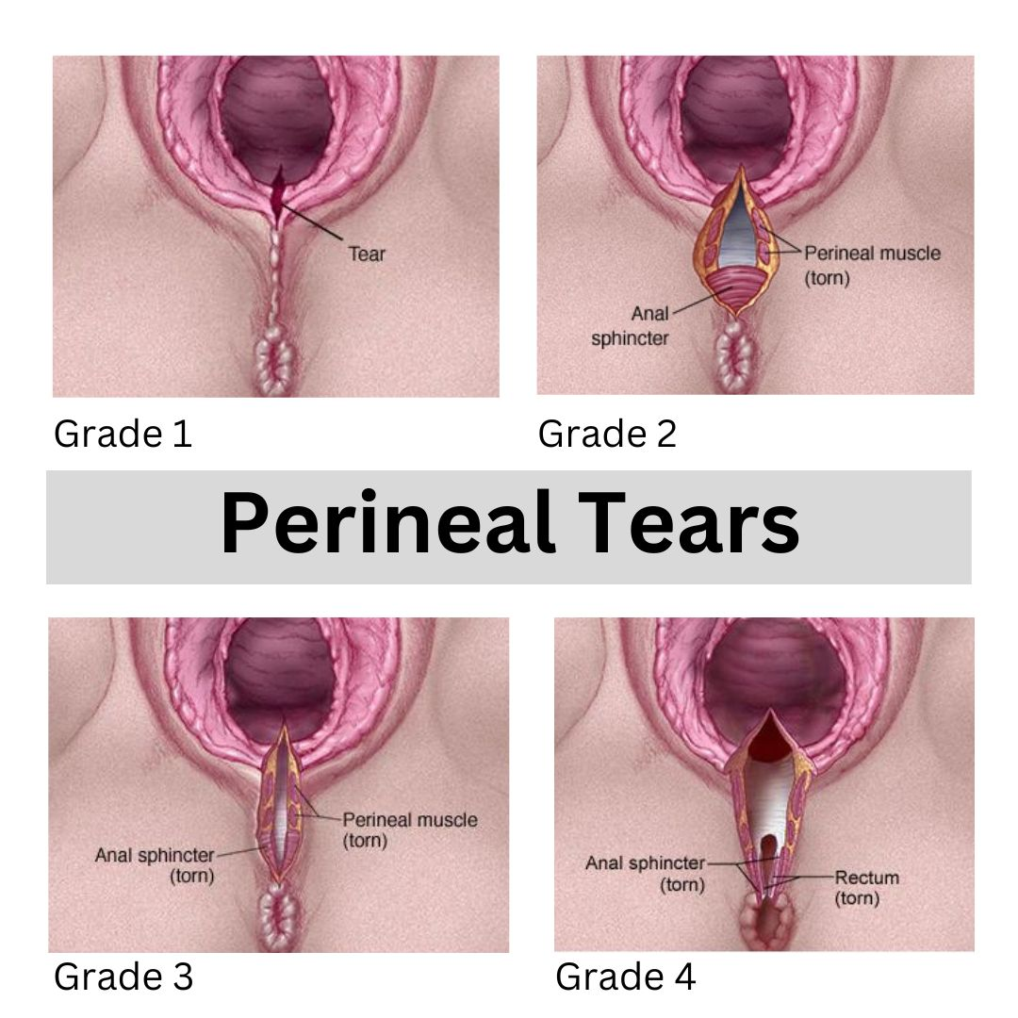
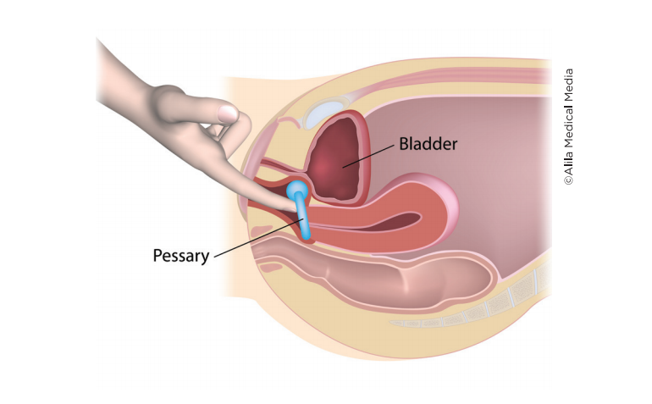
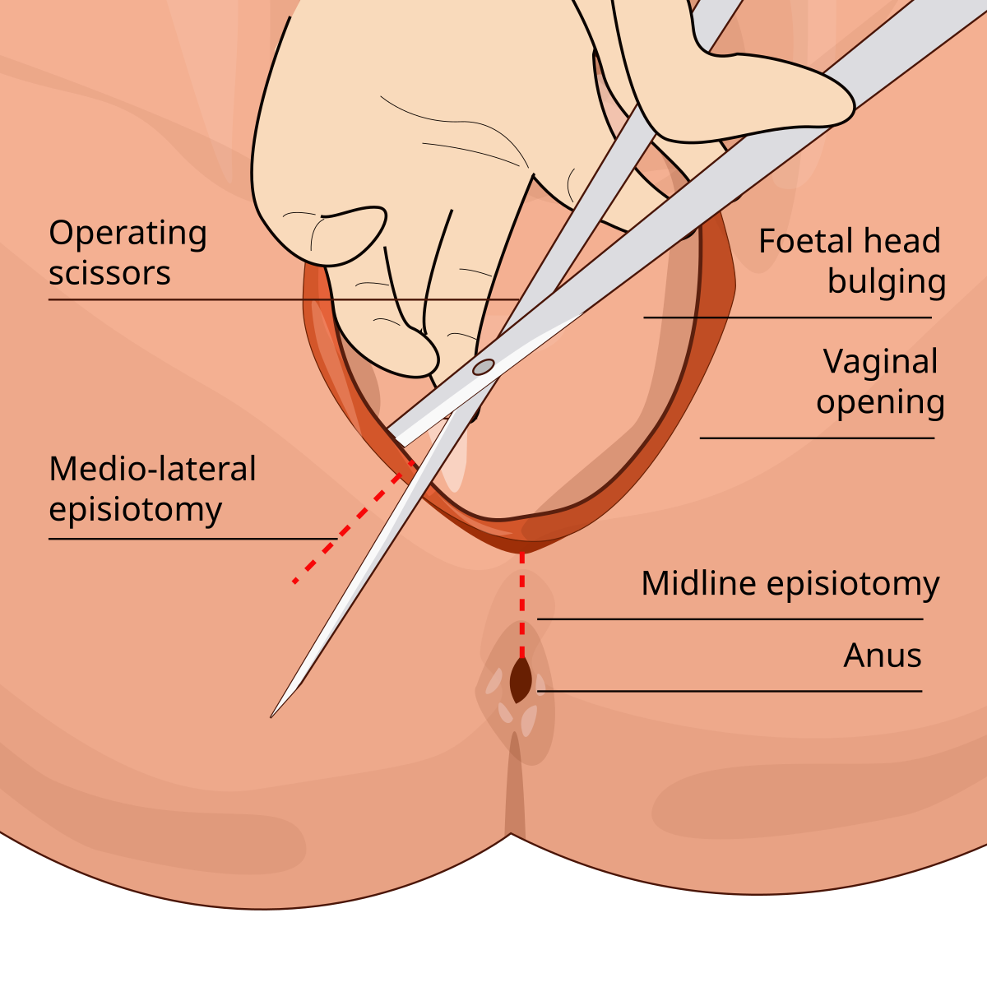
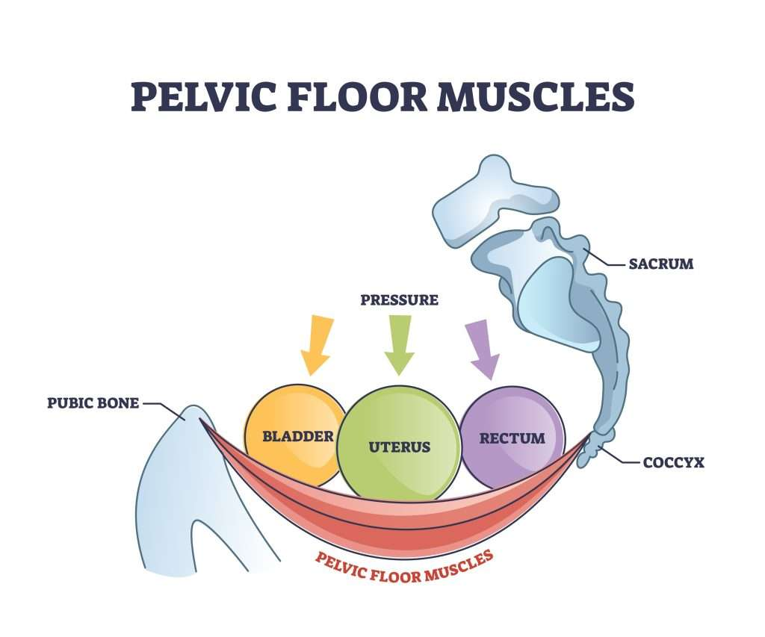
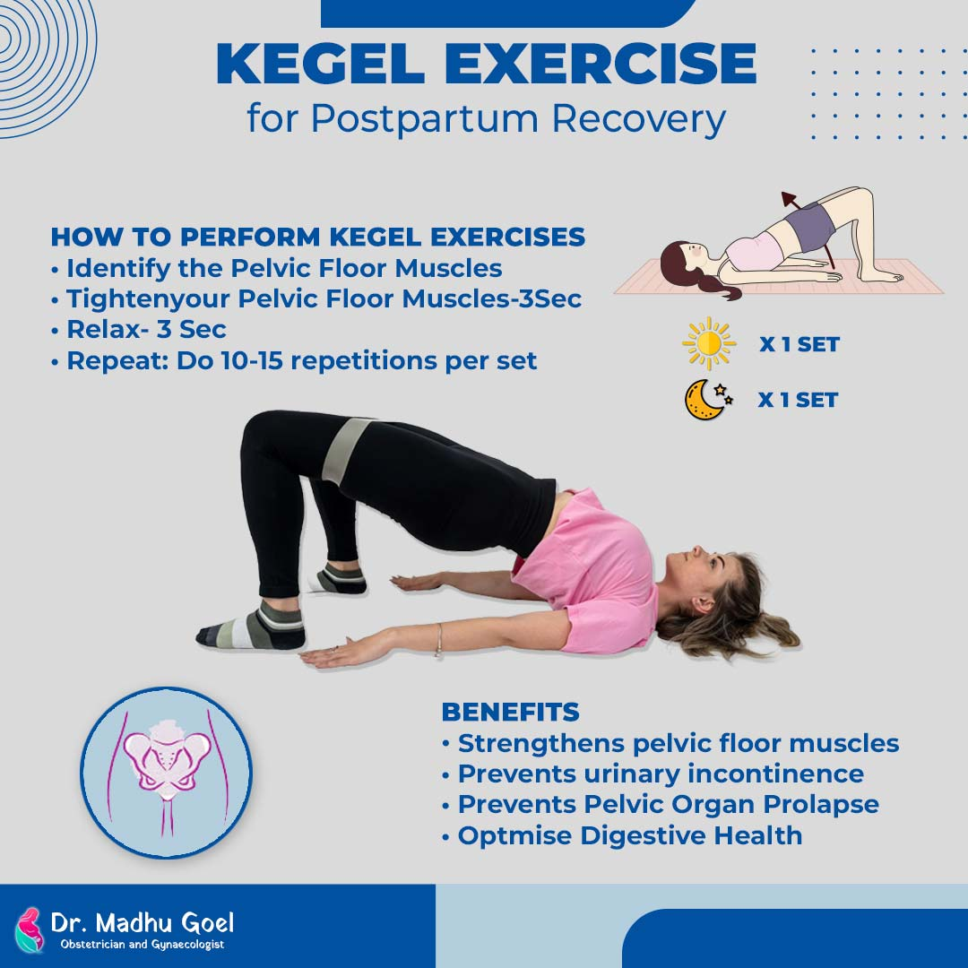

Slide 18
Applied Anatomy of the Female Reproductive System
7. Mammary Glands (Related)
Breast cancer: Common in females; screening via self-exam and mammography.
Mastitis: Inflammation during lactation.
Mastectomy: Surgical removal of breast in carcinoma.

Slide 19
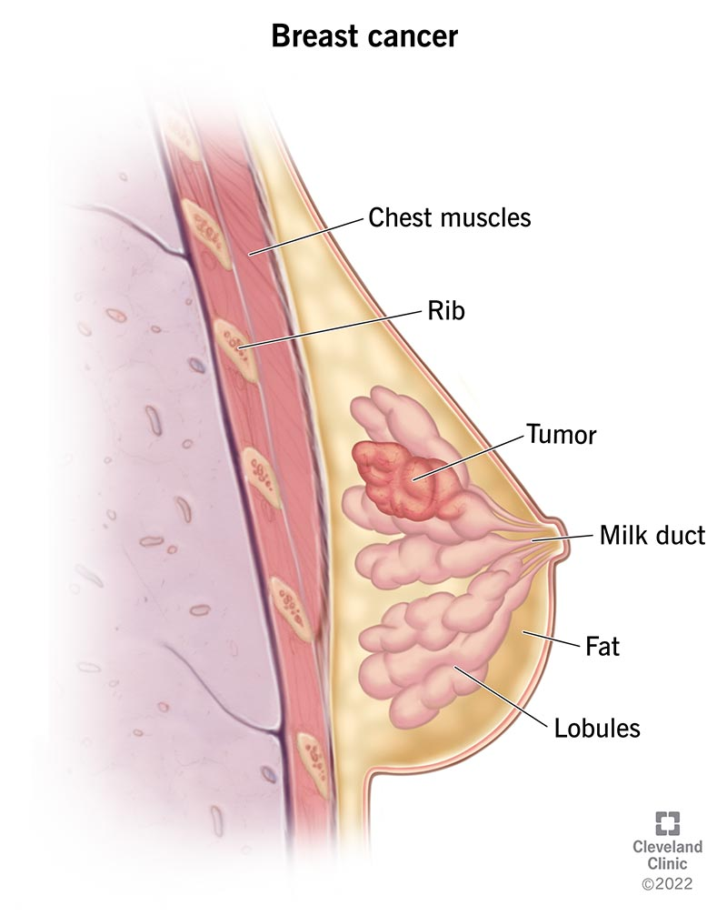
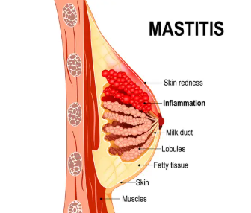
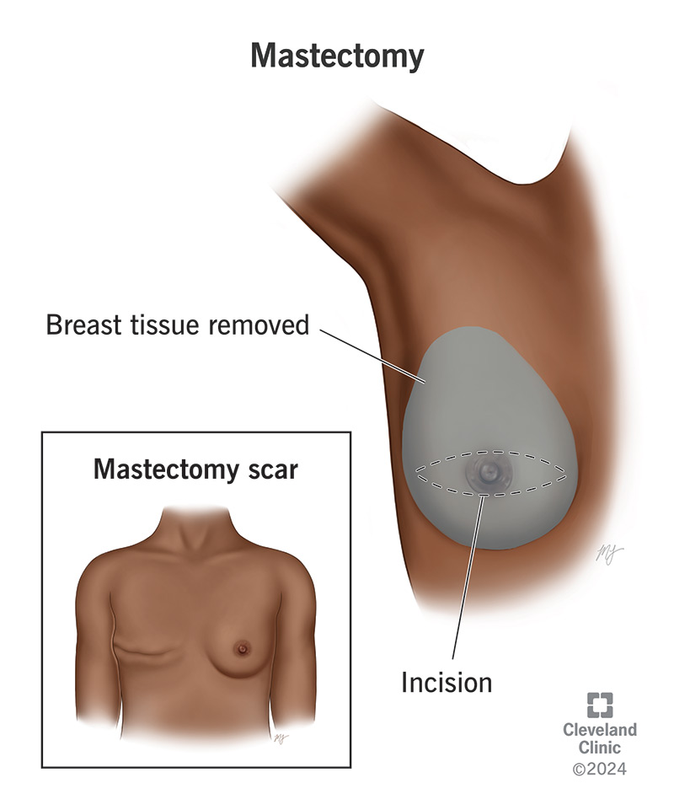

Slide 20
ovary
The ovaries are a pair of female gonads situated in the pelvic cavity, one on each side of the uterus.
The ovary plays a central role in reproduction by regulating the menstrual cycle, ovulation, fertilization, and pregnancy maintenance.

Slide 21
Ovary- situation
The ovaries are paired organs located in the lateral wall of the pelvic cavity.
Each ovary lies in a shallow depression called the ovarian fossa, which is bounded by:
Anteriorly → External iliac vessels
Posteriorly → Ureter and internal iliac vessels
Above → Ureter and uterine tube
Below → Broad ligament
In the nulliparous adult female, the ovary lies in the ovarian fossa on the lateral pelvic wall.
The long axis of the ovary is vertical in position.
It is attached:
Medially → to the uterus by the ovarian ligament
Laterally → to the pelvic wall by the suspensory ligament of the ovary (containing ovarian vessels).
The situation changes with age and parity:
In children → ovary is situated higher, in the abdominal cavity.
In adults → in the true pelvis.
In pregnancy → displaced upward with the enlarged uterus.
In old age → becomes smaller and lies closer to the uterus.

Slide 22
Ovary- size and shape
In a normal adult female (reproductive age):
Length → ~3 cm
Width → ~1.5 cm
Thickness → ~1 cm
Weight → ~5–8 grams
(Size and weight vary with age, menstrual cycle, and pregnancy — largest during reproductive period, smaller before puberty and after menopause.)
The ovary is almond-shaped (oval, flattened from side to side).
It has:
2 poles → upper (tubal) pole & lower (uterine) pole
2 borders → anterior border (with hilum for vessels, nerves, lymphatics) & posterior border (smooth, without hilum)
2 surfaces → medial (facing uterus) & lateral (facing pelvic wall)

Slide 23
Ovary- external features
1. Poles
Upper (Tubal) Pole → Related to the uterine tube and suspensory ligament of ovary (carrying ovarian vessels).
Lower (Uterine) Pole → Attached to the uterus by the ovarian ligament
2. Borders
Anterior Border →
Contains the hilum of the ovary (entry/exit of ovarian vessels, lymphatics, and nerves).
Connected to the broad ligament by a short fold of peritoneum called the mesovarium.
Posterior Border →
Rounded and smooth.
No hilum, free from any attachment.
3. Surfaces
Medial Surface → Faces the uterus and uterine tube.
Lateral Surface → Faces the lateral pelvic wall, lies in ovarian fossa (related to ureter & internal iliac vessels).

Slide 24
Ovary- microscopic structure
The ovary is covered externally and shows two main regions (Cortex & Medulla) under the microscope.
1. Surface Epithelium (Germinal Epithelium)
A single layer of cuboidal cells covering the ovary.
Misnamed as “germinal epithelium” (since ova do not arise from it).
Beneath it lies the tunica albuginea (dense connective tissue layer).
2. Cortex
Outer, denser part of ovary.
Contains ovarian follicles at different stages of development:
Primordial follicles – immature, with primary oocyte surrounded by flat follicular cells.
Primary follicles – with cuboidal granulosa cells.
Secondary follicles – multilayered granulosa cells, theca interna & externa.
Mature (Graafian) follicle – large fluid-filled antrum, ready for ovulation.
After ovulation → follicle transforms into corpus luteum (secretes progesterone).
If no pregnancy → corpus luteum degenerates into corpus albicans (fibrous scar)

Slide 25
Ovary- microscopic structure
3. Medulla
Inner, central part.
Composed of:
Loose connective tissue.
Blood vessels, lymphatics, and nerves.
Smooth muscle fibers.
No follicles are usually found here.
4. Hilum of Ovary
Site where vessels, lymphatics, and nerves enter through the anterior border.
Covered by mesovarium.

Slide 26
Ovary- arterial supply and venous drainage
Arterial Supply of the Ovary
Ovarian artery:
Main arterial supply.
A direct branch of the abdominal aorta (just below renal arteries, at L2 level).
Runs in the suspensory ligament of ovary to reach the ovary.
Uterine artery branch:
From the uterine artery (branch of internal iliac).
Provides a collateral supply to the ovary.
Venous Drainage of the Ovary
Veins form a pampiniform plexus in the mesovarium → drains into a single ovarian vein.
Right ovarian vein → drains directly into the inferior vena cava (IVC).
Left ovarian vein → drains into the left renal vein, then into IVC.

Slide 27
Uterine tubes: fallopian tubes
The fallopian tubes are a pair of muscular tubes that connect the ovaries to the uterus.
Each tube is about 10–12 cm long and lies in the upper border of the broad ligament of uterus.
They serve as the passage for the ovum from the ovary to the uterine cavity.
The usual site of fertilization is the ampulla of the fallopian tube.
Lined by ciliated columnar epithelium → helps in movement of the ovum toward the uterus.
Functions are under the control of ovarian hormones (estrogen ↑ ciliary activity).

Slide 28
Uterine tubes: fallopian tubes- functions
Reception of ovum → fimbriated end picks up the ovulated oocyte.
Transport → ciliary movement & peristalsis move the ovum toward uterus.
Site of fertilization → sperm meets ovum usually in ampulla.
Nutrition → secretions provide nourishment to gametes and zygote.
Transport of zygote → early embryo is carried to the uterine cavity for implantation

Slide 29
Uterine tubes: fallopian tubes- parts
1. Infundibulum
Funnel-shaped lateral end.
Has fimbriae (finger-like projections) → the largest is the ovarian fimbria, attached to ovary.
Opens into the peritoneal cavity through the abdominal ostium.
Function → captures the ovum after ovulation.

Slide 30
Uterine tubes:fallopian tubes- parts
2. Ampulla
Longest and widest part (≈ 5–6 cm).
Thin-walled, highly folded mucosa.
Usual site of fertilization.

Slide 31
Uterine tubes:fallopian tubes- parts
3. Isthmus
Narrow, thick-walled part (≈ 2–3 cm).
Lies medial to ampulla.
Joins the uterus at the uterine wall.

Slide 32
Uterine tubes:fallopian tubes- parts
4. Intramural (Interstitial) Part
Shortest part (~1 cm).
Lies within the uterine wall.
Opens into the uterine cavity through the uterine ostium.

Slide 33
Uterine tubes:fallopian tubes- structure
Gross Anatomy
Each tube is 10–12 cm long, located in the upper border of the broad ligament.
Has four parts (lateral → medial):
Infundibulum (with fimbriae)
Ampulla (longest, widest; site of fertilization)
Isthmus (narrow, thick-walled)
Intramural/Interstitial part (within uterine wall; opens into uterine cavity)

Slide 34
Uterine tubes:fallopian tubes- structure
Microscopic Structure (Wall of Tube)
The wall of the uterine tube has four layers:
Mucosa
Lined by simple columnar epithelium with:
Ciliated cells → move ovum toward uterus.
Secretory (peg) cells → provide nutrition for ovum/sperm.
Highly folded in infundibulum and ampulla, less folded in isthmus.
Muscular Layer
Inner circular and outer longitudinal smooth muscle layers.
Peristaltic contractions help transport ovum/zygote.
Serosa
Outer covering of peritoneum (since tube lies in broad ligament).

Slide 35
Uterine tubes:fallopian tubes- structure
Blood Supply
Arterial: Ovarian artery (from abdominal aorta) + Uterine artery (from internal iliac).
Venous: Pampiniform plexus → ovarian veins

Slide 36
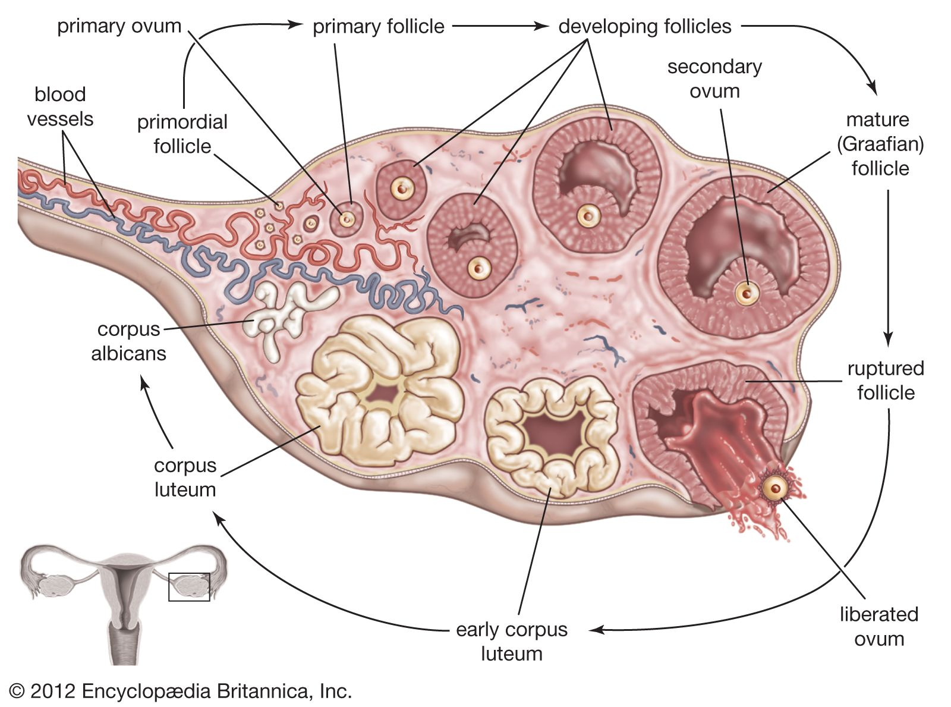
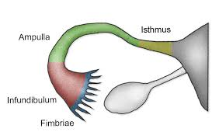
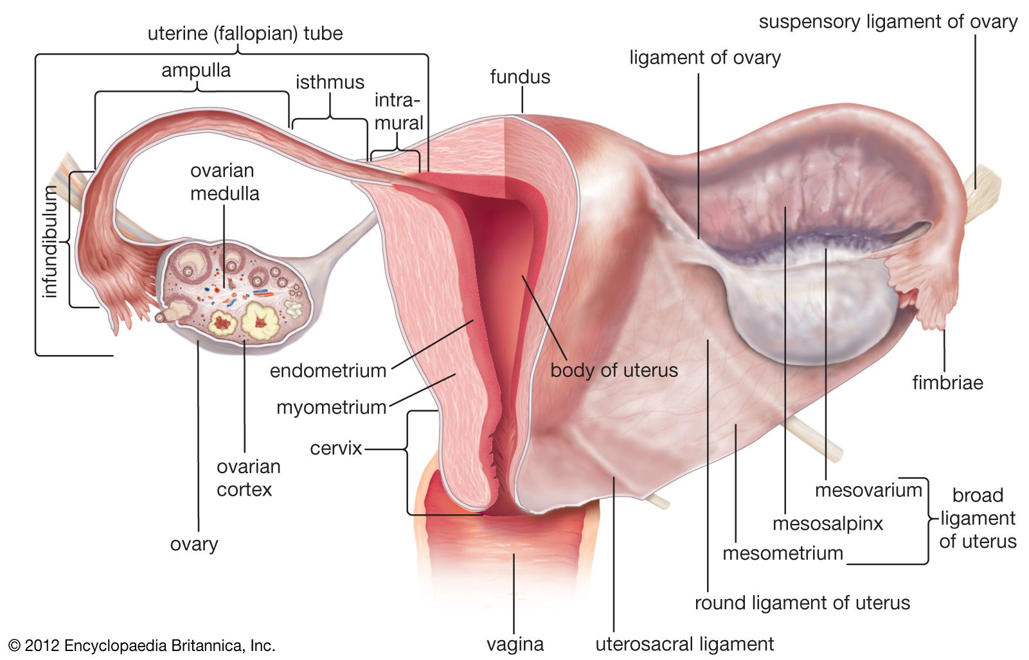
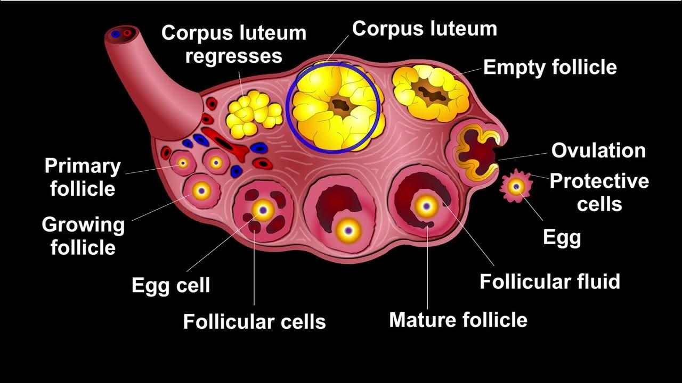
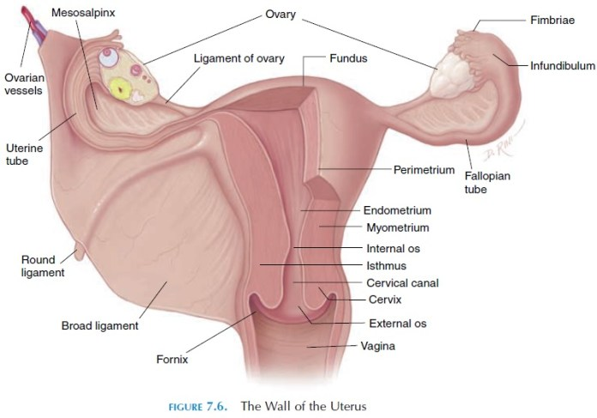

Slide 37
Uterus[womb]
The uterus is a hollow, muscular, pear-shaped organ of the female reproductive system.
It lies in the pelvic cavity, between the urinary bladder (anteriorly) and the rectum (posteriorly).
Normal size in adult nulliparous female: about 7.5 cm long, 5 cm wide, and 2.5 cm thick.
Weight: ~50 g (non-pregnant), increases greatly during pregnancy.
It is the organ of menstruation, implantation, pregnancy, and parturition.
Divided into three main parts:
Fundus – dome-shaped upper part above the openings of fallopian tubes.
Body (corpus) – middle part, forms the bulk of uterus.
Cervix – lower, narrow part that opens into the vagina.
The uterine cavity is small and triangular in shape.
Its wall has three layers:
Perimetrium (outer serosa)
Myometrium (thick muscular layer)
Endometrium (inner mucosal lining, undergoes cyclic changes during menstrual cycle).

Slide 38
Uterus[womb]- functions
Provides site for implantation of fertilized ovum.
Nourishes and protects the developing fetus.
Contracts during labor to expel the fetus.
Undergoes monthly menstrual changes in absence of pregnancy

Slide 39
Uterus[womb]- situation and position
Situation
The uterus lies in the true pelvis of the female, between:
Urinary bladder (anteriorly)
Rectum (posteriorly)
In adults (non-pregnant), the uterus is entirely a pelvic organ.
In children → it lies relatively higher (abdominal cavity).
During pregnancy → enlarges and extends into the abdominal cavity.

Slide 40
Uterus[womb]- situation and position
Position
In the normal adult female, the uterus is:
Anteverted → Long axis of the uterus is bent forward at the junction of cervix and vagina (cervix forms ~90° angle with vagina).
Anteflexed → Body of uterus is bent forward at the junction of body and cervix (~125° angle).
✅ Thus, the uterus normally lies in an anteverted and anteflexed position → resting over the urinary bladder.

Slide 41
Uterus[womb]- situation and position
Abnormal Positions (Clinical Note)
Retroversion → uterus tilts backward.
Retroflexion → body of uterus bends backward over cervix.
These may lead to infertility, backache, or prolapse.

Slide 42
Uterus[womb]- measurements
Measurements of the Uterus (Non-pregnant, Nulliparous Adult Female)
Length → ~7.5 cm
Width → ~5 cm (at fundus)
Thickness (AP diameter) → ~2.5 cm
Weight → ~50 g.

Slide 43
Uterus[womb]- measurements
In Parous Woman (after childbirth)
Length → ~8–9 cm
Width → ~6 cm
Thickness → ~3 cm
Weight → ~80 g

Slide 44
Uterus[womb]- measurements
Changes with Life Stages
Childhood → Small, cervix larger than body.
Reproductive age → Normal adult size as above.
Pregnancy → Enlarges enormously (up to ~30 cm or more, weight ~1000 g at term).
Menopause → Shrinks, becomes atrophic.
.

Slide 45
Uterus[womb]- parts
1. Fundus
Dome-shaped part, located above the openings of the uterine (fallopian) tubes.
Rounded and convex.
Important for clinical assessment (fundal height in pregnancy).

Slide 46
Uterus[womb]- parts
2. Body (Corpus)
Middle and largest part of uterus.
Lies between fundus above and isthmus below.
Cavity: triangular in shape when seen in coronal section.
Walls: thick and muscular (myometrium).
Functions: implantation of fertilized ovum, growth of fetus.

Slide 47
Uterus[womb]- parts
3. Cervix
Lower cylindrical part of uterus.
Projects into the vagina.
Divided into:
Supravaginal part → lies above vagina.
Vaginal part → projects into vagina; external opening = external os.
Cervical canal communicates:
Above → with uterine cavity via internal os.
Below → with vagina via external os

Slide 48
Uterus[womb]- Normal Axes
The uterus is not placed in a straight line with the vagina—it lies in characteristic angles for proper function.
1. Anteversion
The uterus is bent forward at the junction of the cervix and vagina.
Angle between long axis of cervix and long axis of vagina.
Normally about 90° (range 90–100°).

Slide 49
Uterus[womb]- Normal Axes
2. Anteflexion
The uterus is bent forward at the junction of the cervix and body (isthmus).
Angle between long axis of body and long axis of cervix.
Normally about 125° (range 120–125°).

Slide 50
Uterus[womb]- Normal Axes
Clinical Note
Anteversion + anteflexion → normal position of uterus.
Variations:
Retroversion: cervix tilted backward.
Retroflexion: body bent backward.
These abnormal axes can be associated with infertility, prolapse, or pain.

Slide 51
Uterus[womb]- isthmus
The isthmus is the narrowed region of the uterus located between the body and cervix.
It represents the transition zone of the uterus.

Slide 52
Uterus[womb]- Microscopic Structure
1. Endometrium (Mucosa)
Epithelium: Simple columnar with ciliated and secretory cells.
Glands: Simple tubular glands, extend through the thickness of endometrium.
Stroma: Highly cellular connective tissue with spiral arterioles.
Zones:
Stratum functionalis:
Superficial, hormone-sensitive.
Proliferates and sheds during menstrual cycle.
Stratum basalis:
Deep, permanent layer.
Regenerates new functionalis after menstruation.

Slide 53
Uterus[womb]- Microscopic Structure
2. Myometrium
Thickest middle layer.
Made of interlacing bundles of smooth muscle fibers arranged in 3 ill-defined layers:
Inner longitudinal
Middle circular / oblique (rich in blood vessels, “stratum vasculare”).
Outer longitudinal
Highly vascular and hypertrophies during pregnancy

Slide 54
Uterus[womb]- Microscopic Structure
3. Perimetrium (Serosa)
Outermost layer.
Formed by peritoneum covering the uterus.
Consists of mesothelium (simple squamous epithelium) and a thin layer of connective tissue.

Slide 55
Uterus[womb]- Supports
1. Muscular Supports
Pelvic diaphragm (levator ani, especially pubococcygeus & puborectalis) → forms main pelvic floor support.
Perineal body → provides additional support to the pelvic floor.
Urogenital diaphragm → contributes to pelvic stability.

Slide 56
Uterus[womb]- Supports
2. Fibromuscular / Ligamentous Supports
True ligaments of uterus (condensations of pelvic fascia):
Transverse cervical ligaments (Cardinal ligaments / Mackenrodt’s ligaments):
Attach cervix & upper vagina to lateral pelvic wall.
Main support of uterus.
Uterosacral ligaments:
From cervix to sacrum, keep cervix pulled backward.
Pubocervical ligaments:
From cervix to pubis, prevent forward displacement.
Round ligaments of uterus:
Pass from uterine cornu → inguinal canal → labia majora.
Maintain anteverted position of uterus.

Slide 57
Uterus[womb]- Supports
3. Peritoneal Supports
Broad ligament: Double layer of peritoneum extending from uterus to lateral pelvic wall.
Provides a false support (keeps uterus in place but not strong)

Slide 58
Uterus[womb]- Arterial Supply and Venous Drainage
Arterial Supply of Uterus
Main artery: Uterine artery (branch of anterior division of internal iliac artery).
Runs in base of broad ligament → reaches cervix → ascends along lateral margin of uterus.
Gives branches to uterus, anastomoses with ovarian and vaginal arteries.
Other contributors:
Ovarian artery (from abdominal aorta) → supplies fundus and anastomoses with uterine artery.
Vaginal artery (from internal iliac) → supplies cervix and upper vagina.

Slide 59
Uterus[womb]- Arterial Supply and Venous Drainage
Venous Drainage of Uterus
Uterine veins form a rich uterine venous plexus around uterus.
Plexus drains mainly into internal iliac veins.
Some communications:
With ovarian veins (→ left renal vein / IVC).
With vaginal venous plexus.

Slide 60
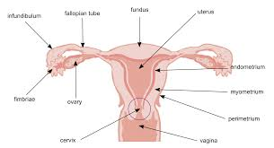
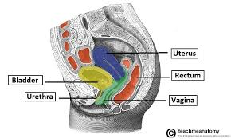
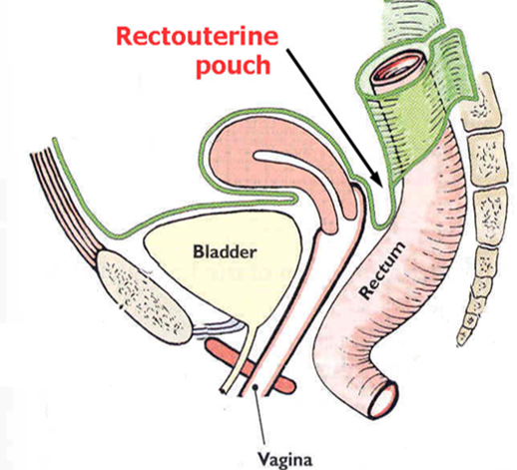
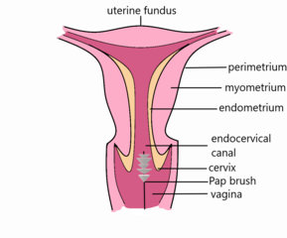
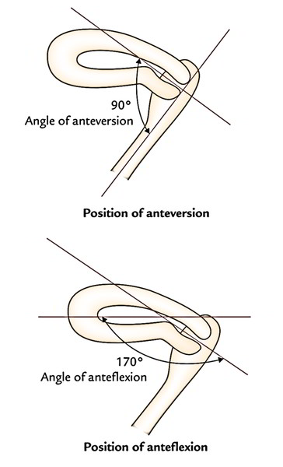

Slide 61
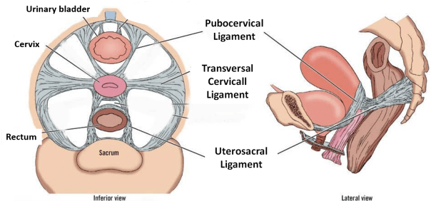
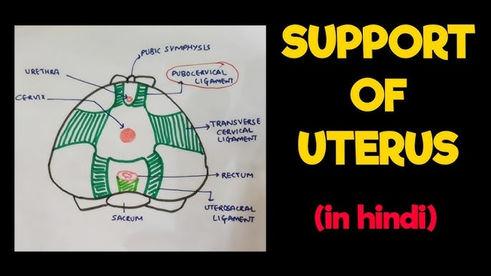
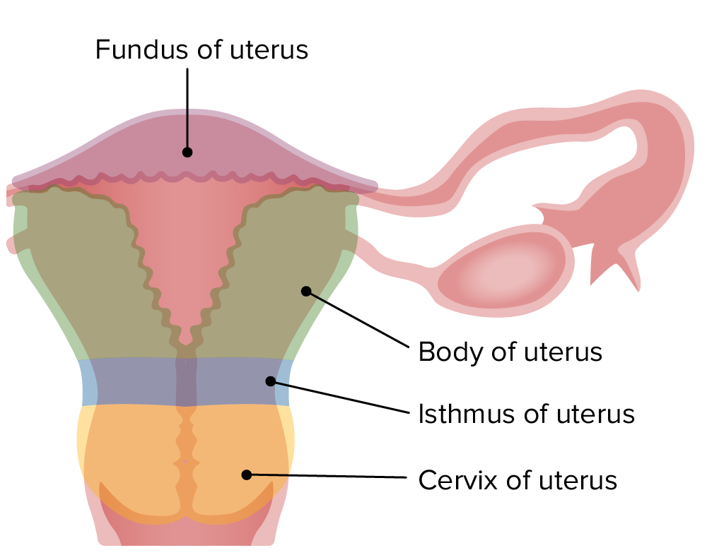

Slide 62
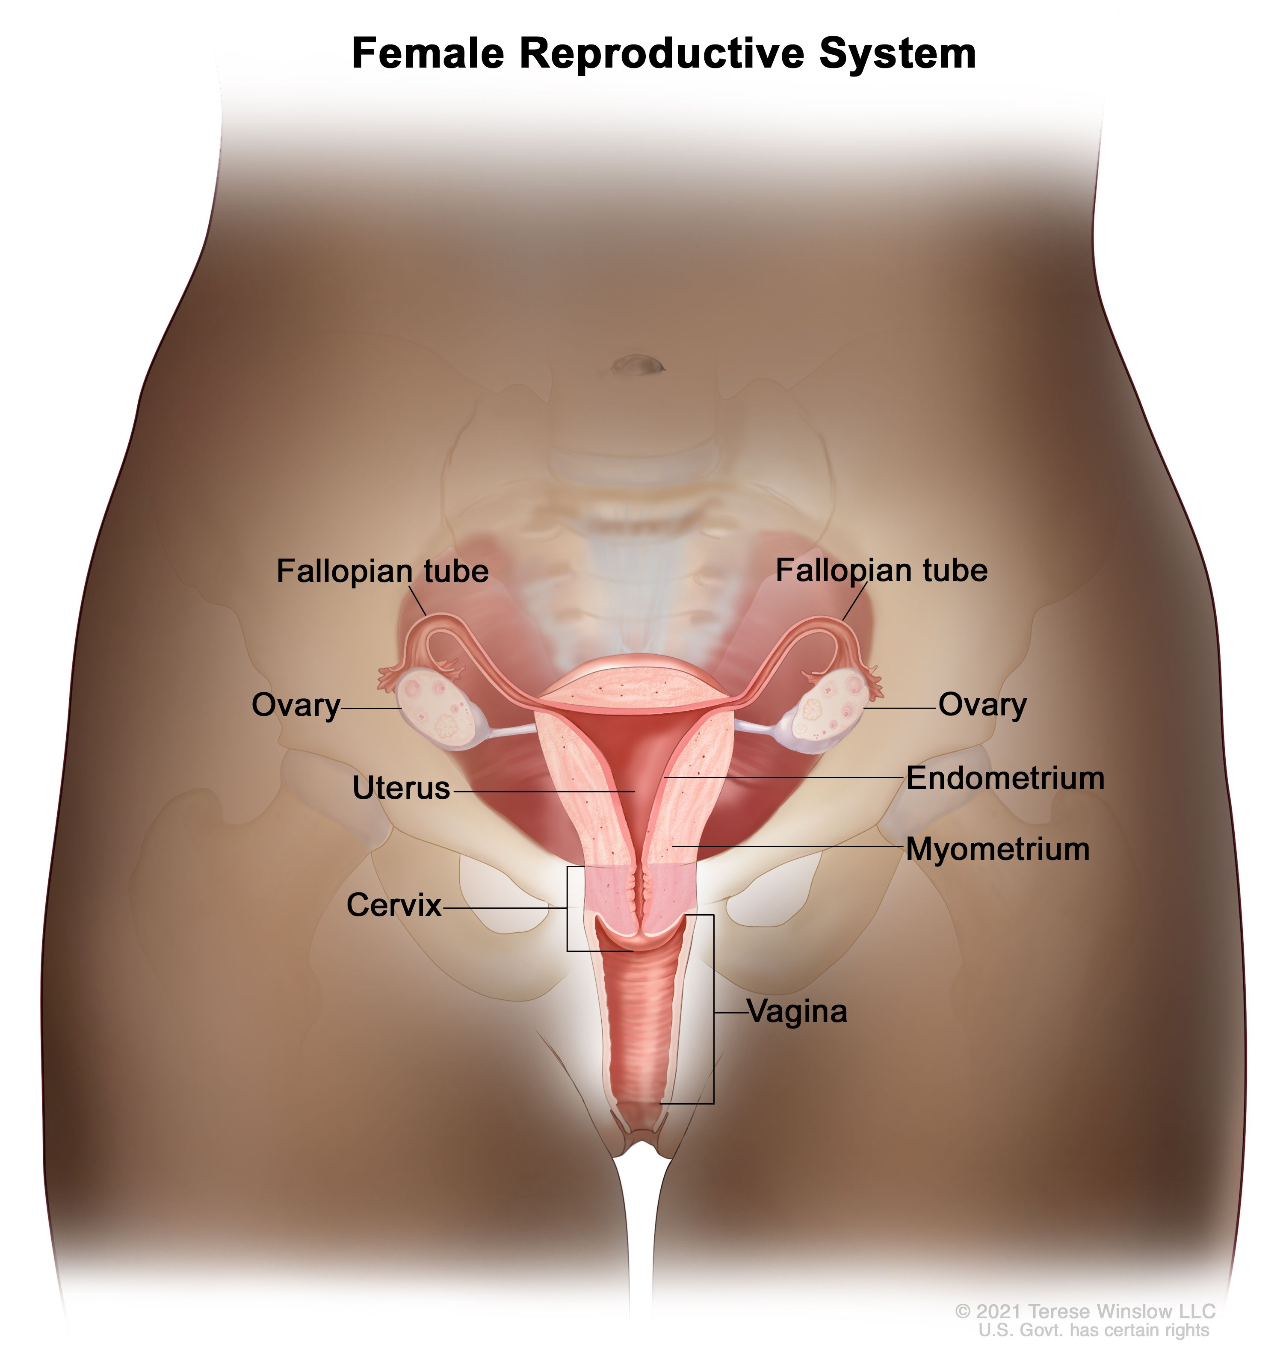
Uterus[womb]- vagina
The vagina is a muscular and tubular part of the female genital tract that connects the external genitalia (vulva) to the uterus. It serves as a passage for menstrual flow, sexual intercourse, and childbirth.

Slide 63
Uterus[womb]- vagina
Location & Relations
Anteriorly: Bladder and urethra
Posteriorly: Rectum and anal canal
Superiorly: Opens into the cervix of the uterus
Inferiorly: Opens externally at the vaginal vestibule

Slide 64
Uterus[womb]- vagina
Structure
Length: About 7–10 cm in an adult woman (varies with age, sexual activity, and hormonal status)
Walls: Composed of three layers:
Mucosa: Stratified squamous epithelium; rich in glycogen → metabolized by lactobacilli to maintain acidic pH (~3.5–4.5)
Muscularis: Smooth muscle fibers arranged in circular and longitudinal layers
Adventitia: Connective tissue with elastic fibers, attaches vagina to surrounding pelvic structures

Slide 65
Uterus[womb]- vagina
Functions
Serves as the birth canal during delivery
Allows menstrual flow from the uterus
Receives the penis during sexual intercourse
Acts as a protective barrier with acidic pH to prevent infections

Slide 66
Uterus[womb]- vagina
Blood Supply
Arterial: Vaginal artery (branch of internal iliac), uterine artery (vaginal branches), internal pudendal artery
Venous: Vaginal venous plexus → internal iliac veins

Slide 67
Uterus[womb]- vagina
Innervation
Somatic: Pudendal nerve (lower 1/3, for sensation)
Autonomic: Parasympathetic fibers from pelvic splanchnic nerves, sympathetic fibers from hypogastric plexus

Slide 68
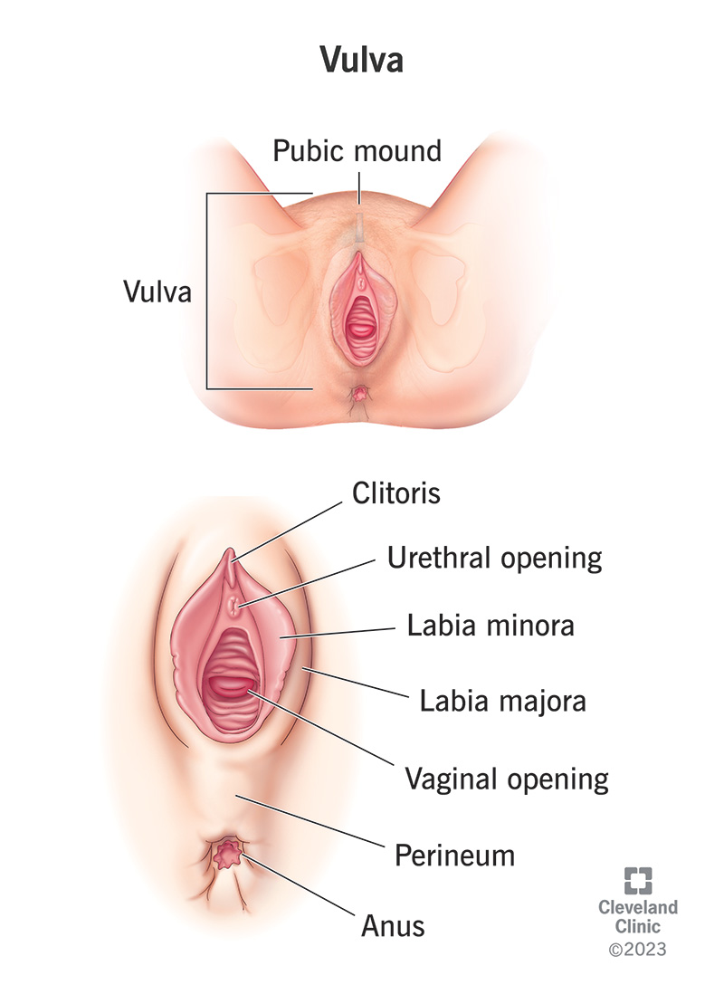
Uterus[womb]- vulva
The vulva is the external female genitalia. It includes all structures visible externally that protect the internal genital organs.

Slide 69
Uterus[womb]- vulva
Components of the Vulva
Mons pubis: Fatty, rounded area over the pubic symphysis, covered with pubic hair after puberty.
Labia majora: Large, thick folds of skin and fatty tissue; protect the inner structures; hair grows on outer surface.
Labia minora: Thin, hairless folds inside the labia majora; highly vascular and sensitive; form the prepuce (hood) of the clitoris.
Clitoris: Small erectile organ; rich in nerve endings; involved in sexual arousal.

Slide 70
Uterus[womb]- vulva
Vestibule of the vagina: Area between labia minora; contains openings of:
Vagina
Urethra
Bartholin’s glands (vestibular glands) – secrete lubricating fluid
Urethral meatus: External opening of the urethra; lies above the vaginal opening.
Hymen: Thin membrane partially covering vaginal opening (variable in shape).
Vestibular glands:
Bartholin’s glands: Lateral sides of vaginal opening; secrete mucus.
Skene’s glands: Near urethral opening; contribute to lubrication.

Slide 71
Uterus[womb]- vulva
Functions
Protects internal genital organs
Provides sexual sensation
Facilitates urination and childbirth
Contributes to lubrication and protection against infections

